Slide 1
Estimation and Inference

Slide 2
Learning Goals
In this section, we will cover:
- Statistical estimation and inference
- Parametric and non-parametric approaches to modeling
- Common statistical distributions
- Frequentist vs. Bayesian statistics

Slide 3
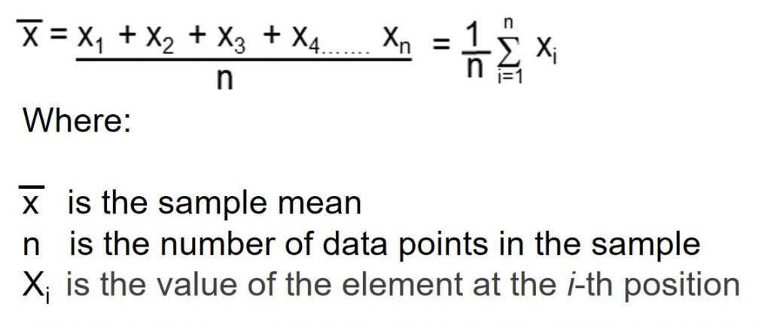
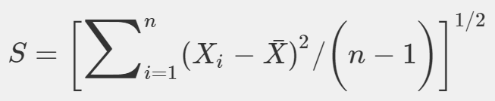
Estimation vs. Inference
Estimation: is the application of an algorithm, for example taking an average:
Inference: involves putting an accuracy on the estimate
(e.g. standard error of an average):

Slide 4
Machine Learning and Statistical Inference
Machine learning and statistical inference are similar
(a case of computer science borrowing from a long history in statistics).
In both cases, we're using data to learn/infer qualities of a distribution that generated the data (often termed the data-generating process).
We may care either about the whole distribution or just features (e.g. mean).
Machine learning applications that focus on understanding parameters and individual effects involve more tools from statistical inference (some applications are focused only on results).

Slide 5
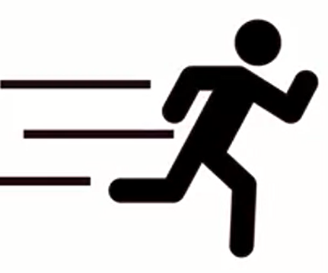
Example: Customer Churn
Customer churn occurs when a customer leaves a company
Data related to churn may include a target variable for whether or not the customer left
Features could include:
-The length of time as a customer
- The type and amount purchased
- Other customer characteristics
Churn prediction is often approached by predicting a score for individuals that estimates the probability the customer will leave.

Slide 6
Customer Churn: Estimation
Estimation of factors driving customer churn involves measuring the impact of each factor in predicting churn
Inference involves determining whether these measured impacts are statistically significant

Slide 7
Customer Churn: Example Dataset
IBM Cognos Customer Churn Dataset:
- Data from fictional telecommunications firm
- Includes account type, customer characteristics,
revenue per customer, satisfaction score, estimate of customer lifetime value
- Includes information on whether customer churned (and some categories of churn type)

Slide 8
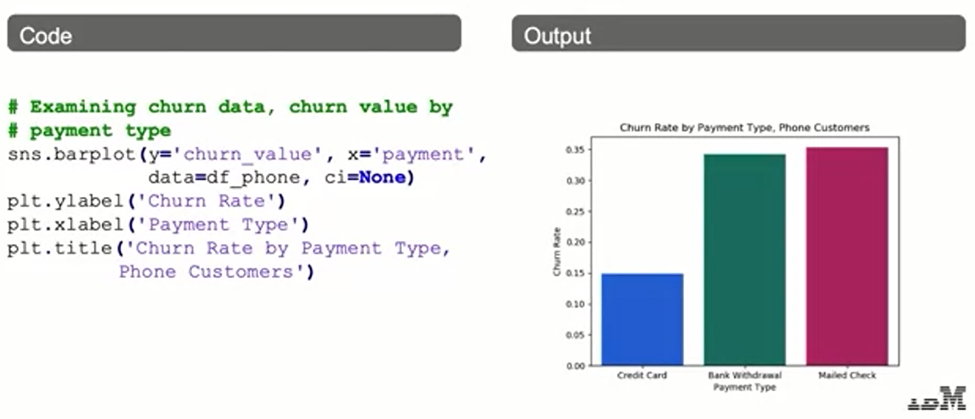
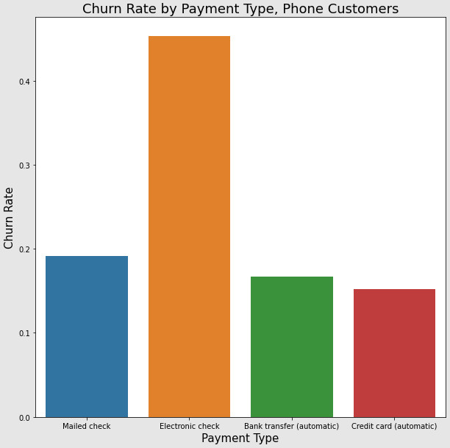
Customer Churn Example: Plotting

Slide 9
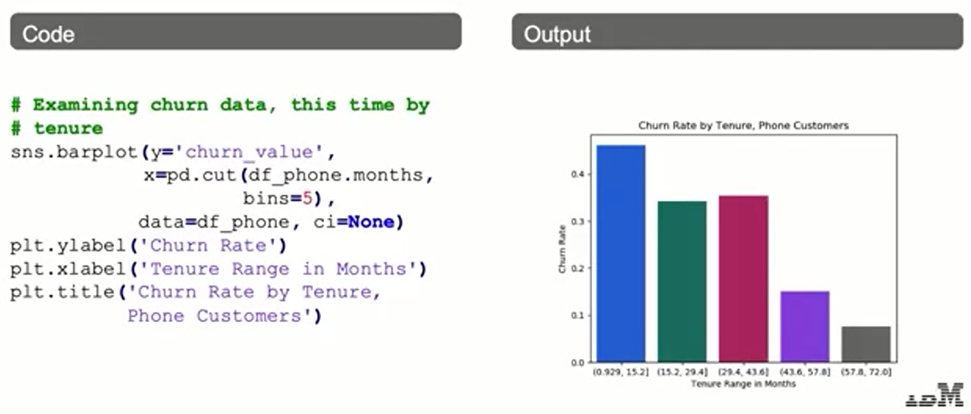
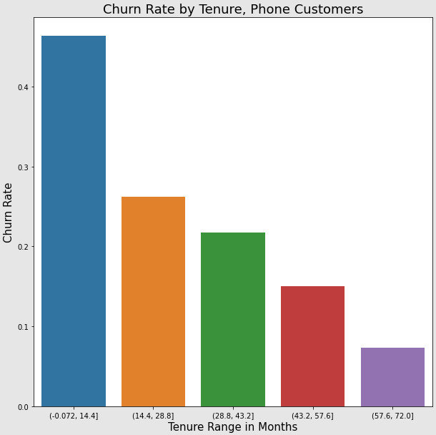
Customer Churn Example: Plotting

Slide 10
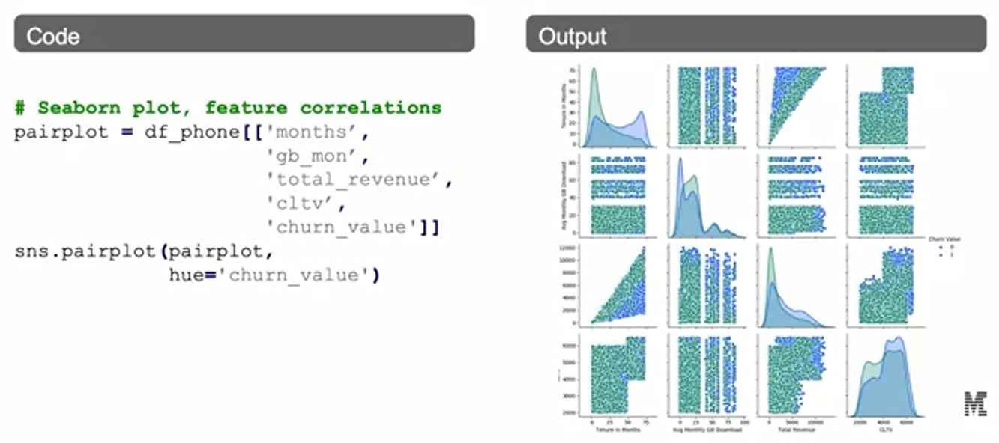
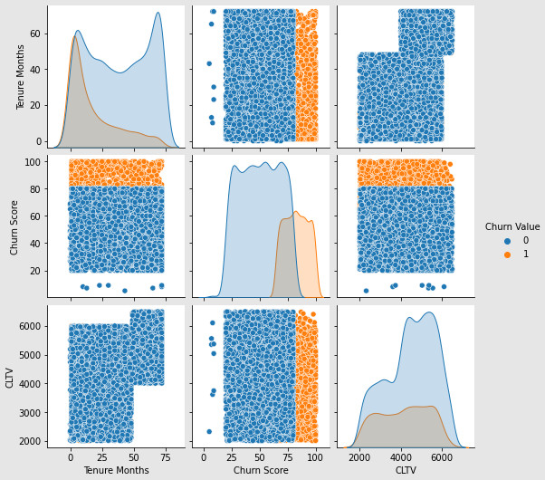
Customer Churn Example: Plotting

Slide 11
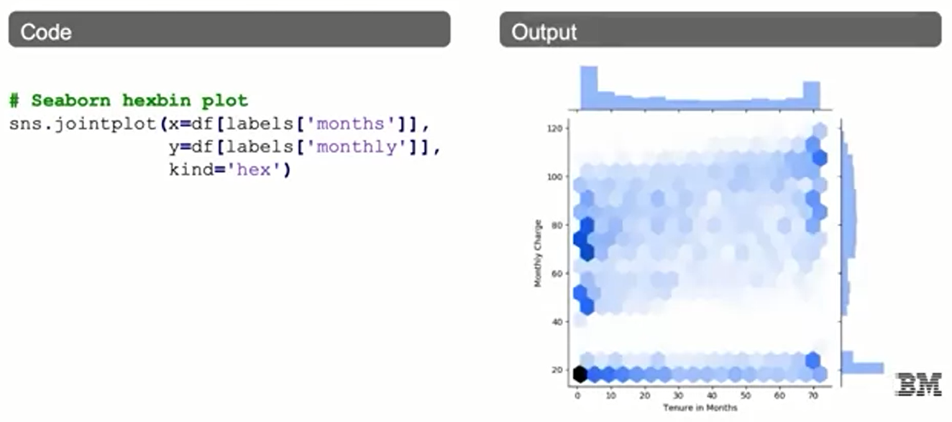
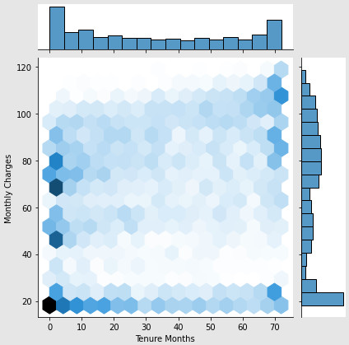
Customer Churn Example: Plotting

Slide 12
Parametric vs. Non-parametric
If inference is about trying to find out the Data-Generating Process (DGP), then we can say that a statistical model (of the data) is a set of possible distributions or maybe even regressions.
A parametric model is a particular type of statistical model: it's also a set of distributions or regressions, but they have a finite number of parameters.

Slide 13
Non-parametric Statistics
In non-parametric statistics, we make fewer assumptions.
In particular, we don't assume that the data belong to any particular distribution (also called distribution-free inference).
This doesn't mean that we know nothing, though!

Slide 14
Non-parametric Inference
An example of non-parametric inference is creating a distribution of the data (CDF or cumulative distribution function) using a histogram.
In this case, we're not specifying parameters.

Slide 15
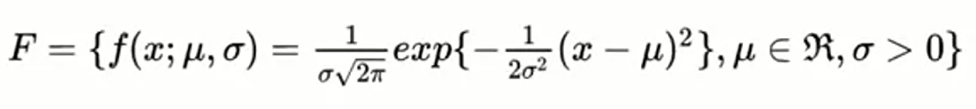
Parametric Models
A parametric model is a particular type of statistical model: it's also a set of distributions or regressions, but they have a finite number of parameters.
An example of a parametric model: the Normal Distribution.

Slide 16
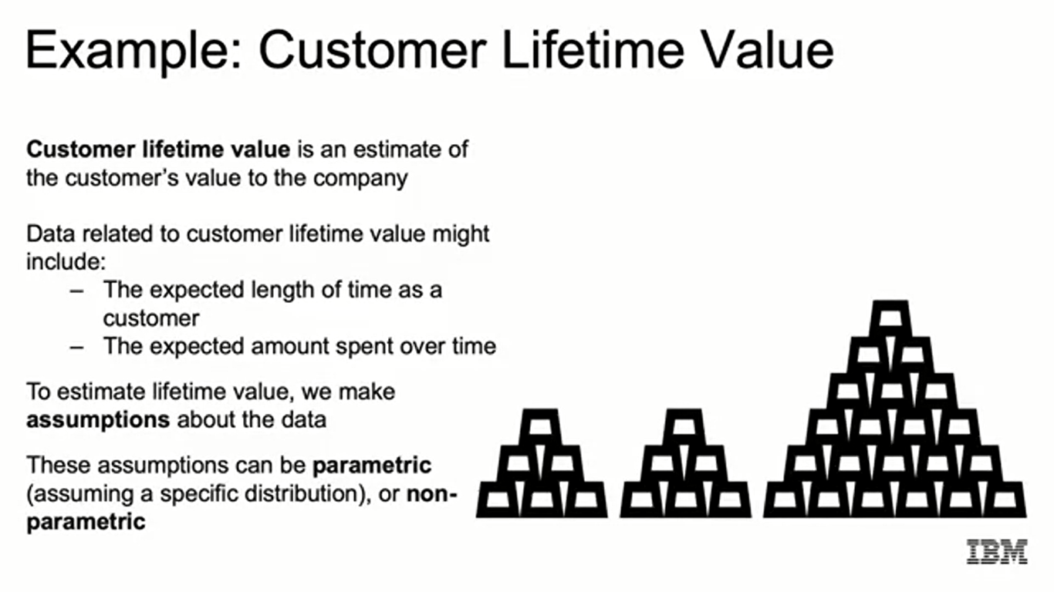
Example: Customer Lifetime Value
Customer lifetime value is an estimate of the customer's value to the company
Data related to customer lifetime value might include:
- The expected length of time as a customer
- The expected amount spent over time
To estimate lifetime value, we make assumptions about the data
These assumptions can be parametric (assuming a specific distribution), or non- parametric

Slide 17
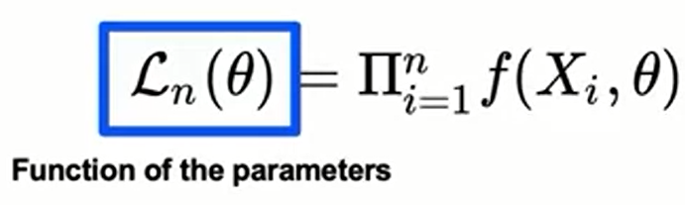
Parametric Models: Maximum Likelihood
The most common way of estimating parameters in a parametric model is through maximum likelihood estimation (MLE).
The likelihood function is related to probability and is a function of the parameters of the model:

Slide 18
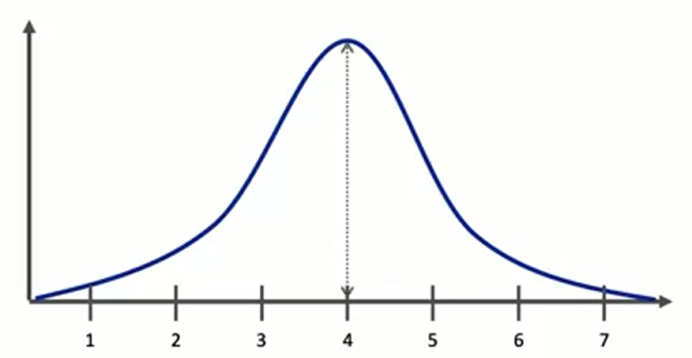
Parametric Models: Maximum Likelihood
We choose the value of 0 (parameters) that maximizes the likelihood function.

Slide 19
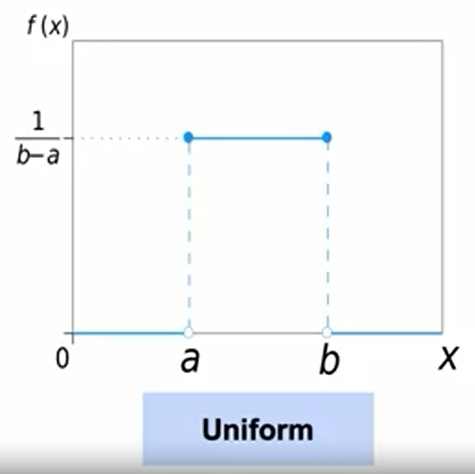
Commonly Used Distributions

Slide 20
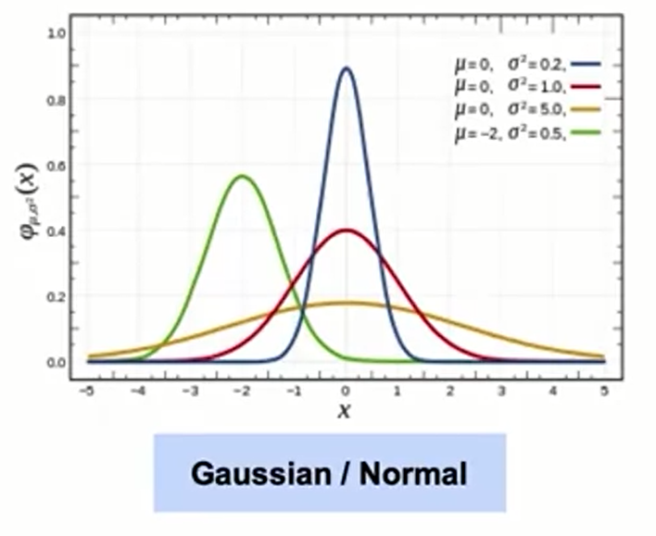
Commonly Used Distributions

Slide 21
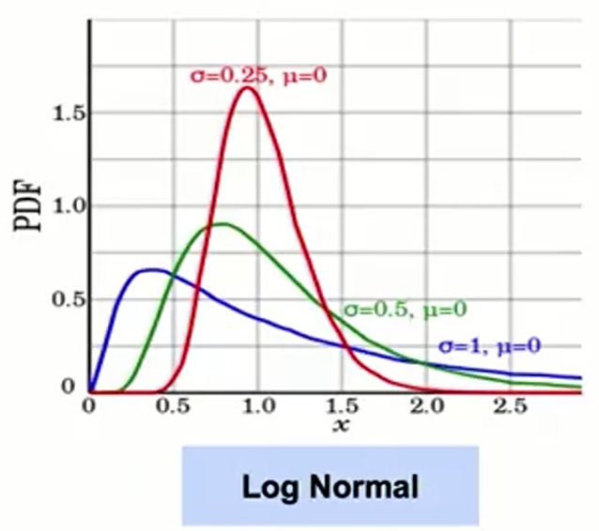
Commonly Used Distributions

Slide 22
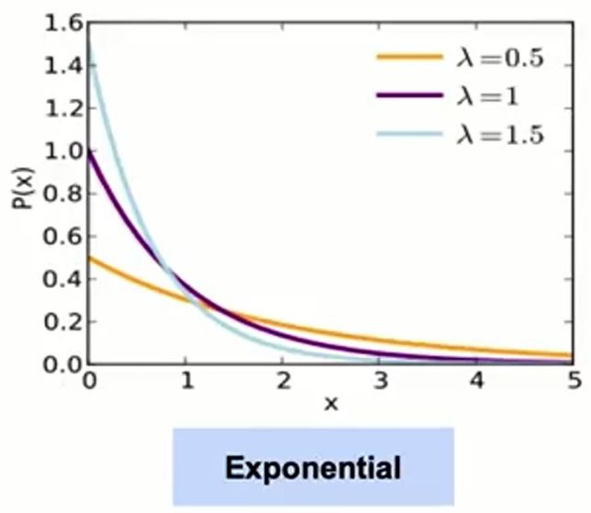
Commonly Used Distributions

Slide 23
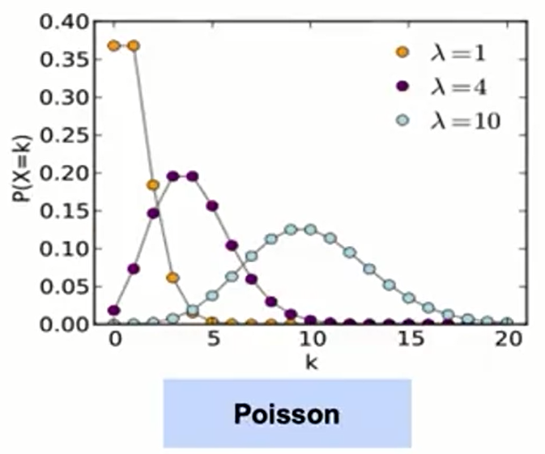
Commonly Used Distributions

Slide 24
Frequentist vs. Bayesian Statistics
A Frequentist is concerned with repeated observations in the limit.
Processes may have true frequencies, but we're interested in modeling probabilities as many, many repeats of an experiment.
Frequentist approach:
Derive the probabilistic property of a procedure
Apply the probability directly to the observed data

Slide 25
Frequentist vs. Bayesian: Bayesian
A Bayesian describes parameters by probability distributions.
Before seeing any data, a prior distribution (based on the experimenters' belief) is formulated.
This prior distribution is then updated after seeing data (a sample from the distribution).
After updating, the distribution is called the posterior distribution.

Slide 26
Frequentist vs. Bayesian: Bayesian
We will consider two examples of probabilistic systems:
Coin flips - What is the probability of an unfair coin coming up heads?
Election of a particular candidate for UK Prime Minister - What is the probability of seeing an individual candidate winning, who has not stood before?

Slide 27
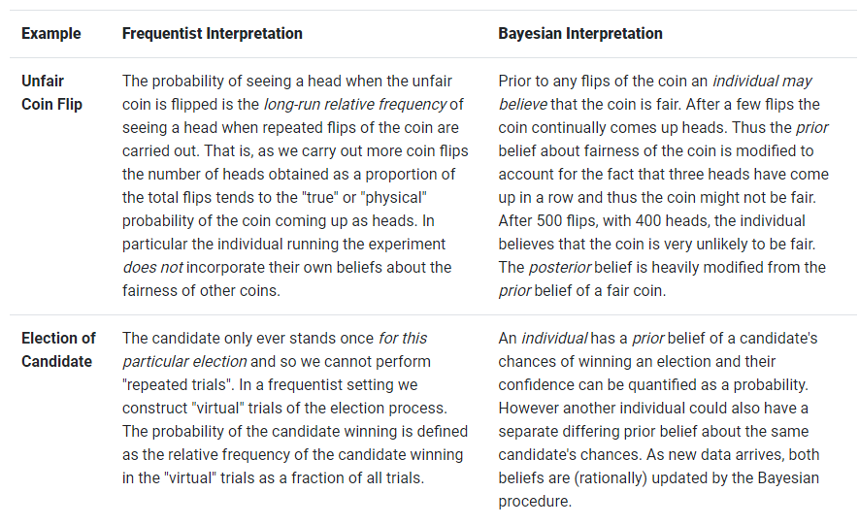
Frequentist vs. Bayesian: Bayesian

Slide 28
Frequentist vs. Bayesian Statistics
We use much of the same math and the same formulas in both Frequentist and Bayesian statistics.
The element that differs is the interpretation.
We will point out the difference in interpretation, where appropriate.

Slide 29
Summary
Estimation and Inference
Inferential Statistics consist in learning characteristics of the population from a sample. The population characteristics are parameters, while the sample characteristics are statistics. A parametric model, uses a certain number of parameters like mean and standard deviation.
The most common way of estimating parameters in a parametric model is through maximum likelihood estimation.
Through a hypothesis test, you test for a specific value of the parameter.
Estimation represents a process of determining a population parameter based on a model fitted to the data.
The most common distribution functions are: uniform, normal, log normal, exponential, and poisson.
A frequentist approach focuses in observing man repeats of an experiment. A bayesian approach describes parameters through probability distributions.

Slide 30
Learning Recap
In this section, we discussed:
- Statistical estimation and inference
- Parametric and non-parametric approaches to modeling
- Common statistical distributions
- Frequentist vs. Bayesian statistics

